Slide 1
Hardware and Software Requirements for Internet connection
S.S.NACHIYA
DEPT., OF C.S.,

Slide 2
Hardware and Software Requirements for Internet connection
The following are the methods of connecting a computer to the Internet using software and hardware peripherals.
Three
• Connecting a computer using Wireless Broadband
Connecting a computer using an Ethernet Cable
Connecting a Computer Using Dial-Up Community

Slide 3
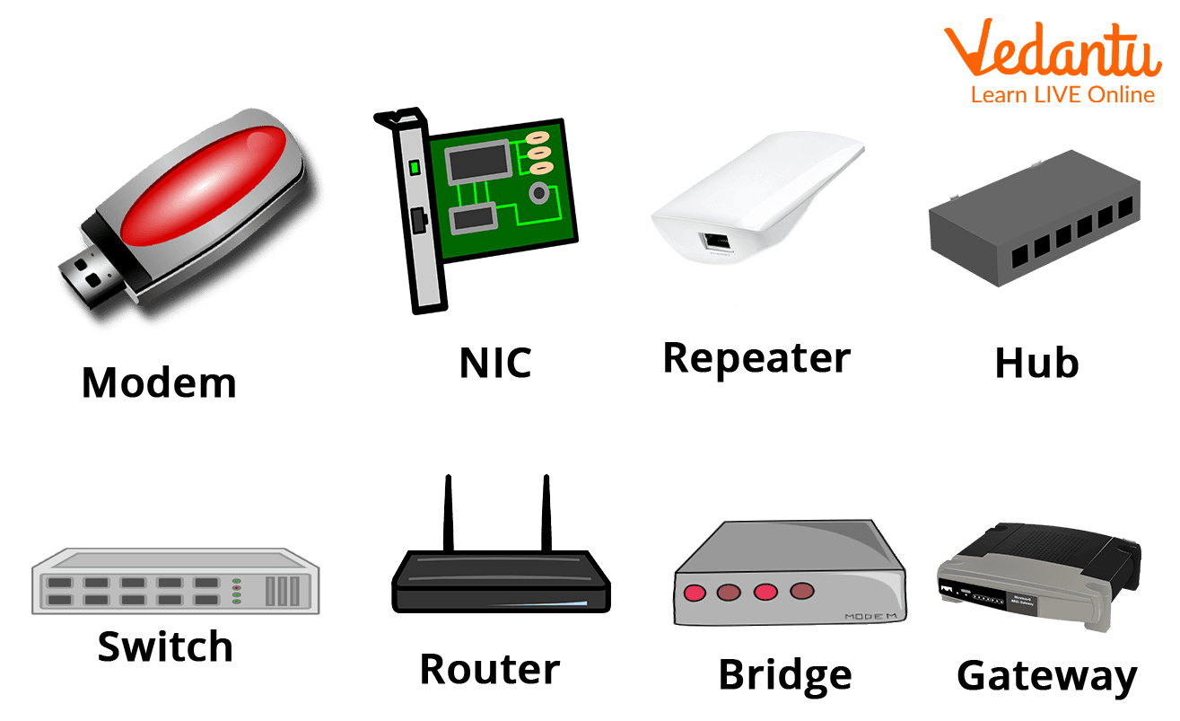
Hardware Requirements of the Internet
The Internet is connected over a telephone connection using a Modem.
The most crucial piece of hardware needed to connect to the Internet is the NIC - Network Interface Card (wired/wireless) facility. For instance, the laptop might be tethered or wirelessly connected to the internet.
Utilising a cellular network, a dongle is used to connect to the Internet.
A Wi-Fi router or hotspot is used when using a wireless network to access the Internet.
Cellular network-capable electronic device.
Internet connectivity through wired and wireless (cellular) networks, cable TV, ISDN, DSL, and dial-up connections.

Slide 4
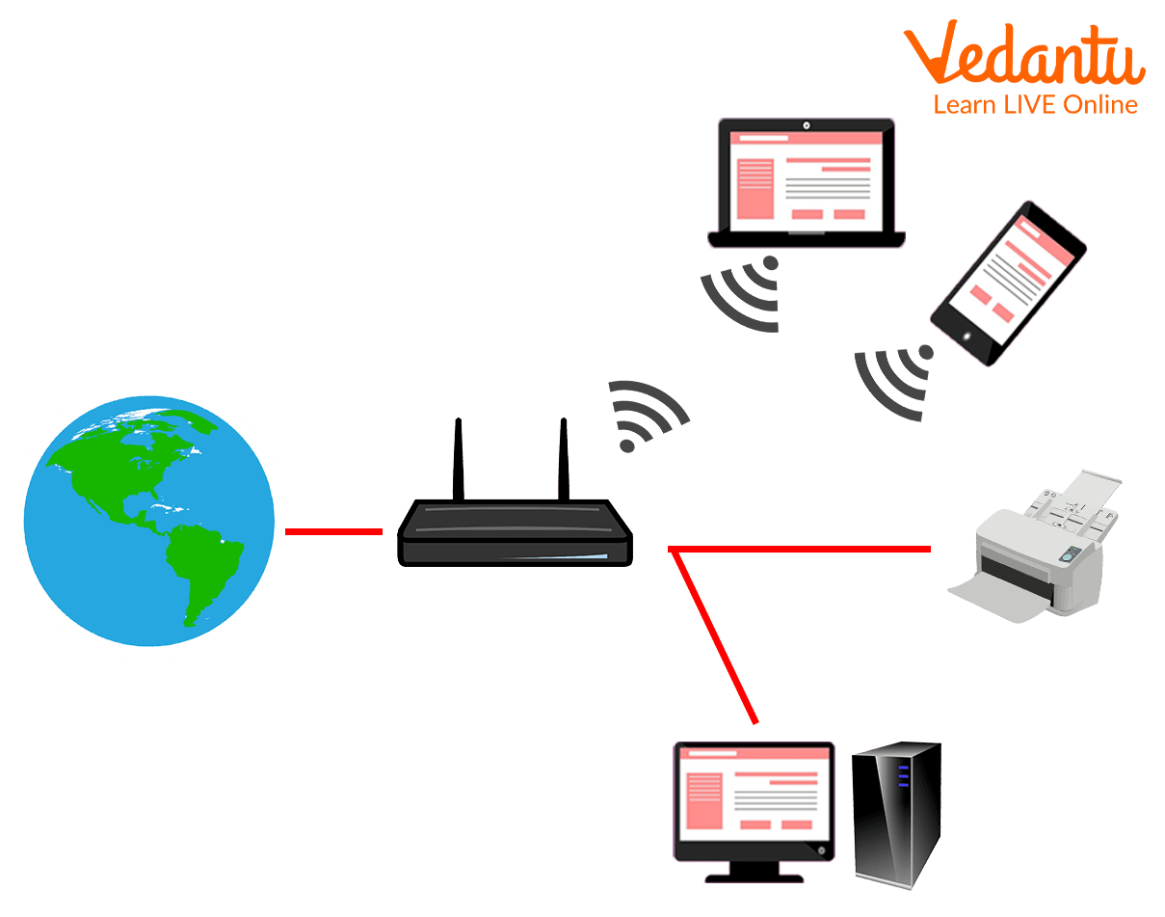
Software Requirement
The operating system should support the TCP/IP (Transfer Control Protocol) and HTTP (HyperText Transfer Protocol Secure) protocols, as well as SMTP (Simple Mail Transfer Protocol), FTP (File Transfer Protocol), and HTTP (HyperText Transfer Protocol).
Access to web apps like Outlook, Gmail, Whatsapp, Facebook, Twitter, and others through browsers and other Internet clients.

Slide 5
Other Requirements for Internet Connection Setup
You require a computer, a connecting device, and an ISP in order to access the internet (ISP). An ISP is a firm that connects people, companies, and organisations to the internet. Additionally, it could offer services like storage space for your personal data. A personal computer, a laptop, a tablet, or a hand-held device like a smartphone can be a computing device.
Additionally, you'll want a network connection device of some kind. This may be a router linked to your phone line, a wireless network or a network provided by a mobile phone operator. Usually, the item you need to connect is already incorporated into your computer equipment, but it can also be externally linked. You connect to your ISP via this connection.
You can physically connect to your network connection device using a cable or a wireless method. This wireless method will often use the Wi-Fi protocol. The Wi-Fi standard is compatible with the majority of wireless devices.

Slide 6
Types of Equipment Required to Set Up Internet Connection
To connect to the Internet, the following tools are needed:
A modem
A phone line
Modem: You don't need a lot of extra gear to connect to the Internet once you have your computer. A modem is the main piece of gear you require. The modem you require depends on the type of Internet access you select.
Router: A router is a piece of hardware that enables you to create a home network or many computers and other devices connected to a single Internet connection. You may build a home wireless network, sometimes known as a Wi-Fi network, because many routers are wireless.
References:
https://www.brainkart.com/article/Hardware-and-Software-Requirements-for-Internet-connection_36836/
https://www.vedantu.com/computer-science/hardware-and-software-requirement-for-the-internet

